Slide 1

Chapter 4
data structures and Algorithms
Stack
Data Structure

Slide 2
Contents
Stack Definition,
Stack Operations,
Stack Implementation
  using array,
  using linked lists,
Applications of Stacks,
Polish Notation and Expression Conversion
  infix, postfix and prefix expressions using stack,

Slide 3
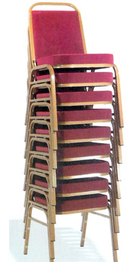
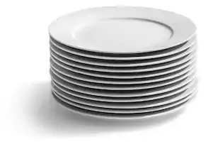
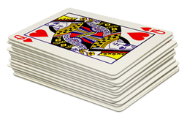
4.1. Stack
A stack is a list with the restriction that insertions and deletions can be performed in only one position, namely, the end of the list, called the top.
A stack is also an Abstract Data Type (ADT), commonly used in most programming languages.
It is named stack as it behaves like a real-world stack,
  for example – a deck of cards or a pile of plates, stack of chairs etc.

Slide 4
Stack ADT
Stack ADT allows all data operations at one end only.
  At any given time, we can only access the top element of a stack.
Each stack ADT has a data member, commonly named as top, which points to the topmost element in the stack.
The fundamental operations on a stack are
  push, which is equivalent to an insert, and
  pop, which deletes the most recently inserted element.
In a stack, the element deleted from the set is the one most recently inserted:
  the stack implements a last-in, first-out, or LIFO, policy.

Slide 5
A stack can be implemented by means of Array, Structure, Pointer, and Linked List. Stack can either be a fixed size one or it may have a sense of dynamic resizing.

Slide 6
4.2. Stack Operations
Basic Operations
Push - Pushing (storing) an element on the stack.
Pop - Removing (accessing) an element from the stack.
Supportive operations
GetTop - reads (only reading, not deleting) an element from the top of the stack
Stack_initialization - sets up the stack in an empty condition
isEmpty - checks whether the stack is empty
isFull - checks whether the stack is full

Slide 7
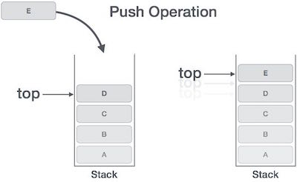
Push Operation
Push Operation
The process of putting a new data element onto stack is known as a Push Operation.
Push operation involves a series of steps −
  Step 1 − Checks if the stack is full.
  Step 2 − If the stack is full, produces an error and exit.
  Step 3 − If the stack is not full, increments top to point next empty space.
  Step 4 − Adds data element to the stack location, where top is pointing.
  Step 5 − Returns success.

Slide 8
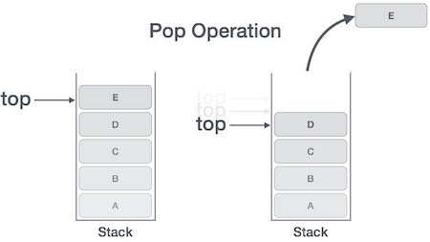
pop Operation
Pop Operation
Accessing the content while removing it from the stack, is known as a Pop Operation.
  Array vs linked list ?
A Pop operation may involve the following steps
  Step 1 − Checks if the stack is empty.
  Step 2 − If the stack is empty, produces an error and exit.
  Step 3 − If the stack is not empty, accesses the data element
  at which top is pointing.
  Step 4 − Decreases the value of top by 1.
  Step 5 − Returns success.

Slide 9
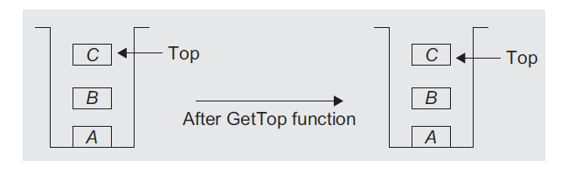
GetTop
This returns the top element of the stack without actually popping it.
Gives information about the topmost element.
  The top is still set to the same element (no change)
  This is the key difference between the pop and getTop operations.

Slide 10
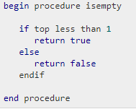
isEmpty
Simply tests whether the stack is empty or not.
This operation is useful as a safeguard against an attempt to pop an element from an empty stack.
Popping an empty stack is an error condition known as stack underflow.

Slide 11
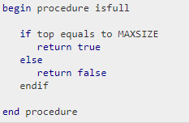
isFull
In ideal conditions, stacks should possess infinite capacity so that the subsequent elements can always be pushed, regardless of the number of elements already present on the stack.
However, computers always have finite memory capacity, and we do need to check the stack_full condition before doing push operation.
  Pushing an element in a full stack is an error condition know as stack overflow.
Simply tests whether the stack is full or not.

Slide 12
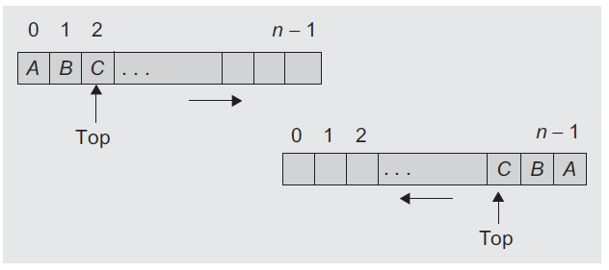
4.3. Stack implementation
Can be implemented using both a static data structure (array) and a dynamic data structure (linked list).
Array implementation
  The simplest way to represent a stack is by using a one-dimensional array.
  A stack implemented using an array is also called a contiguous stack.
  It is very simple to manage a stack when represented using an array. (ordered elements)
  The only difficulty with an array is its static memory allocation.

Slide 13
Stack implementation (using array)
One of the two sides of the array can be considered as the top (upper) side and the other as the bottom (lower)
  the upper side is most commonly used
The first element is stored at Stack[0], the second element at Stack[1]…..last Stack[n-1]
Associated with the array will be an integer variable, top, which points to the top element in the stack.
  The initial value of top is -1 when the stack is empty.
  It can hold the elements from index 0, and can grow to a maximum of n - 1 as this is a static stack using arrays.

Slide 14
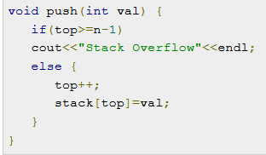
CONT…
Stack size and initial value of top should be defined globally
  int stack[100], n=100, top=-1;
the push() function takes argument val i.e. value to be pushed into the stack.
If a top is greater than or equal to n, there is no space in a stack and overflow is printed. Otherwise, val is pushed into the stack.

Slide 15
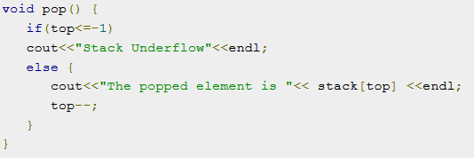
CONT…
The pop() function pops the topmost value of the stack, if there is any value.
If the stack is empty then underflow is printed.

Slide 16
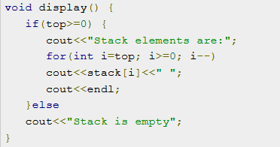
CONT…
The display() function displays all the elements in the stack.
If there are no elements in the stack, then Stack is empty is printed.

Slide 17
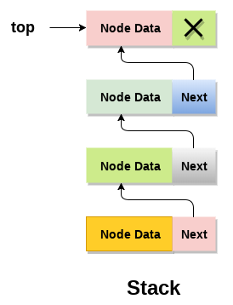
Stack implementation (using linked list)
In linked list implementation of stack, the nodes are maintained non contiguous in the memory.
Stack is said to be overflown if the space left in the memory is not enough to create a node.

Slide 18
Adding a node to the stack (Push operation)
Pushing an element to a stack in linked list implementation is different from that of an array implementation. In order to push an element onto the stack, the following steps are involved.
1. Create a node first and allocate memory to it.
2. If the list is empty then the item is to be pushed as the start node of the list. This includes assigning value to the data part of the node and assign null to the address part of the node.
3. If there are some nodes in the list already, then we have to add the new element in the beginning of the list (to not violate the property of the stack). For this purpose, assign the address of the starting element to the address field of the new node and make the new node, the starting node of the list.

Slide 19
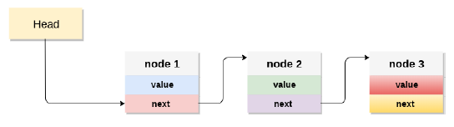
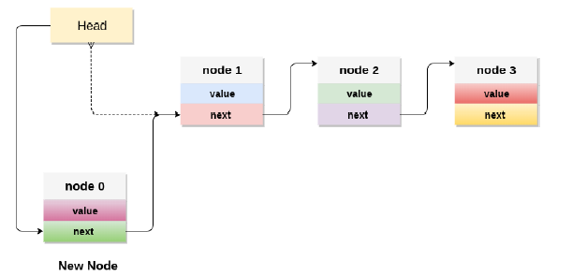

Slide 20
Deleting a node from the stack (POP operation)
Deleting a node from the linked list implementation of stack is different from that in the array implementation. In order to pop an element from the stack, we need to follow the following steps
1. Check for the underflow condition: The underflow condition occurs when we try to pop from an already empty stack. The stack will be empty if the head pointer of the list points to null.
2. Adjust the head pointer accordingly: In stack, the elements are popped only from one end, therefore, the value stored in the head pointer must be deleted and the node must be freed. The next node of the head node now becomes the head node.

Slide 21
Display the nodes (Traversing)
Displaying all the nodes of a stack needs traversing all the nodes of the linked list organized in the form of stack. For this purpose, we need to follow the following steps.
1. Copy the head pointer into a temporary pointer.
2. Move the temporary pointer through all the nodes of the list and print the value field attached to every node.

Slide 22
Implementing Operations on Linked List Implementation of Stack
the structure Node is used to create the linked list that is implemented as a stack
    struct Node {
    int data;
    Node *next;
    };
    Node* top = NULL;

Slide 23
PUSH Operation: push function inserts an element (or new node) at the front of the list.
There is no need to test whether or not stack is full (dynamic allocation of space) because there is no upper limit.
    void push(int val)
    {
    Node *temp = new(Node)
    temp->data = val;
    temp->next = top;
    top = temp;
    }

Slide 24
POP Operation: POP operation performs the following function.
  If stack is empty, it prints a warning message and halts program execution.
  Removes the element at the front of the list.
      void pop()
      {
      if(top==NULL)
      cout <<"Stack Underflow"<<endl;
      else
      {
      cout <<"The popped element is "<< top->data <<endl;
      top = top->next;
      }
      }

Slide 25
4.4. Application of stack
Used in a wide range of applications
Converting infix expression to postfix and prefix expressions
Evaluating the postfix expression
Checking well-formed (nested) parenthesis
Reversing a string
Processing function calls
Parsing (analyze the structure) of computer programs
Simulating recursion
In computations such as decimal to binary conversion
In backtracking algorithms (often used in optimizations and in games)

Slide 26
EXPRESSION EVALUATION AND CONVERSION
The most frequent application of stacks is in the evaluation of arithmetic expressions.
An arithmetic expression is made of operands, operators, and delimiters.
How to generate machine language instructions that could properly evaluate any arithmetic expression? X = (A/B + C x D - F x G/Q)
Might have several meanings, and even if the meanings were uniquely defined, it is still difficult to generate a correct and reasonable instruction sequence.
Fortunately, with the help of stack we can solve the problem in both elegant and simple way.
the order in which the operations are to be carried out?

Slide 27
Polish Notation and Expression Conversion
The Polish Mathematician Jan Lukasiewicz suggested a notation called Polish notation, which gives two alternatives to represent an arithmetic expression, namely the postfix and prefix notations.
The fundamental property of Polish notation is that the order in which the operations are to be performed is determined by the positions of the operators and operands in the expression.
Hence, the advantage is that parentheses is not required while writing expressions in Polish notation.

Slide 28
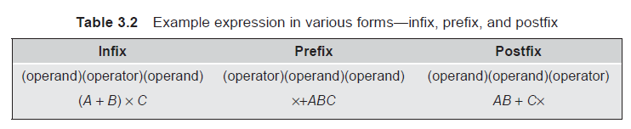
Cont.…
The conventional way of writing the expression is called infix, because the binary operators occur between the operands, and unary operators precede their operand.
  For example, the expression ((A + B) x C)/D is an infix expression.
In postfix notation, the operator is written after its operands, whereas in prefix notation, the operator precedes its operands.

Slide 29
Need for Prefix and Postfix Expressions
Evaluation of an infix expression using a computer needs proper code generation by the compiler without any ambiguity and is difficult because of various aspects such as the operator’s priority and associativity.
The postfix and prefix expressions possess many advantages as follows:
  The need for parenthesis as in an infix expression is overcome in postfix and prefix notations.
  The priority of operators is no longer relevant.
  The order of evaluation depends on the position of the operator but not on priority and associativity.
  The expression evaluation process is much simpler than attempting a direct evaluation from the infix notation.

Slide 30
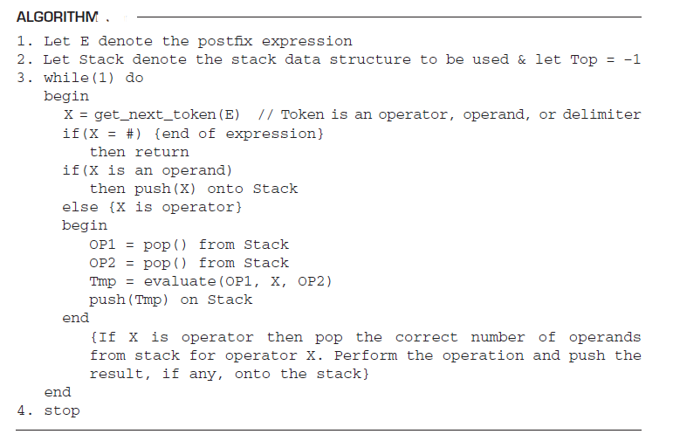
A2: Postfix Expression Evaluation

Slide 31
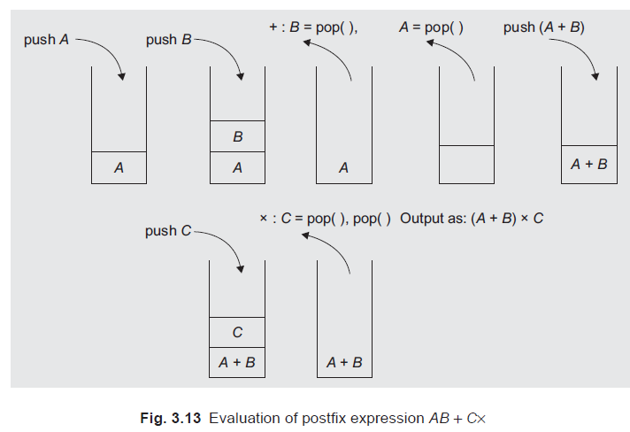
an example postfix expression E = AB + Cx#.

Slide 32
manually converting an expression
Initially, fully parenthesize the given infix expression. Use operator precedence and associativity rules for the same.
Now, move all operators so that they replace their corresponding right/left parenthesis.
Finally, delete all parentheses, and we get the postfix/prefix expression.

Slide 33
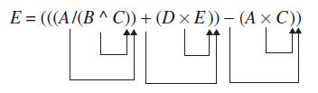
Example: manually converting infix to postfix
E = A/B ^ C + D \ E - A \ C
Let us fully parenthesize the same as
  E = (((A/(B ^ C)) + (D \ E)) - (A \ C))
Let us move all operators to the corresponding right parenthesis and replace the same.
Now let us eliminate all parentheses. We get the postfix equivalent of the infix expression.
E(postfix) = ABC ^/ DE x+ AC x -

Slide 34

Example: manually converting infix to prefix
E = A/B ^ C + D \ E - A \ C
Let us fully parenthesize the same as
  E = (((A/(B ^ C)) + (D \ E)) - (A \ C))
Let us move all operators to the corresponding right parenthesis and replace the same.
Now let us eliminate all parentheses. We get the prefix equivalent of the infix expression.
E(prefix) = - +/ A ^ BC x DE x AC

Slide 35
algorithm to convert an infix to a postfix (also to prefix)
The order of the operand remains the same in the infix and the postfix notations.(from observation)
The sequence of operands, output postfix = input infix expression.
Hence, the operands from the infix expression can be immediately sent to the output as they occur.
To handle the operators, the operands are stored in the stack until the right moment and they are unstacked (removed from the stack); they are then passed to the output.
Try 1
  If in stack operator priority is greater than the incoming operator, pop the operator otherwise push it

Slide 36
Infix to Postfix Conversion
The following is a simple algorithm to convert infix expression to postfix:
Scans characters in given expression from left to right.
If character is an operand
  Immediately place onto the output
If character is an operator
  If top operator has lower priority or left parentheses
Push operator onto stack
  Otherwise
    Pop operator from the stack and place onto the output until find an entry of lower priority or until we find left parentheses
If character is parenthesis
  If it is right parentheses
    Pop entries from the stack and place onto the output until find left parentheses, pop the left parentheses too but do not place onto the output
  Otherwise
  Push the left parenthesis onto stack
If no character (reach end of the expression)
  Pop entries from the stack and place onto the output until the stack is empty

Slide 37
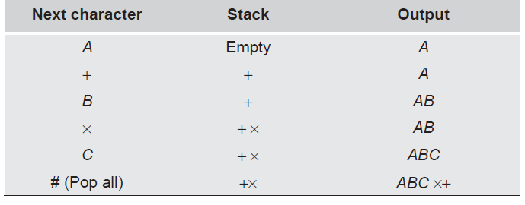
Example 1 (Testing)
Let E be an infix expression as E = A + B x C#
After conversion, the expression should yield ABCx+, that is, the sequence of stacking them should be as
How to handle brackets ?

Slide 38
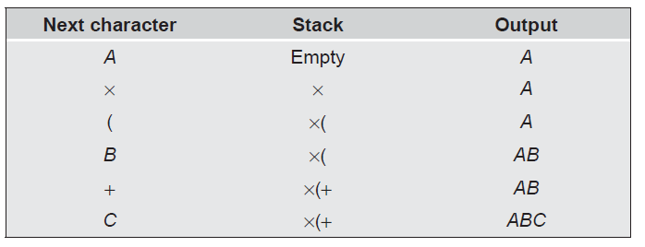
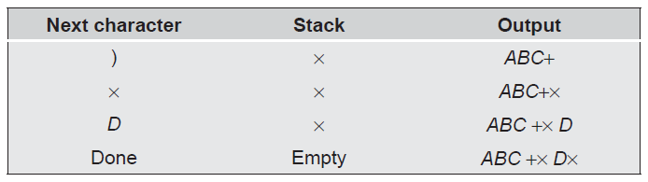
Example 2 (Testing)
The infix expression A x (B + C) x D, after conversion, should generate the postfix expression ABC +x Dx,

Slide 39
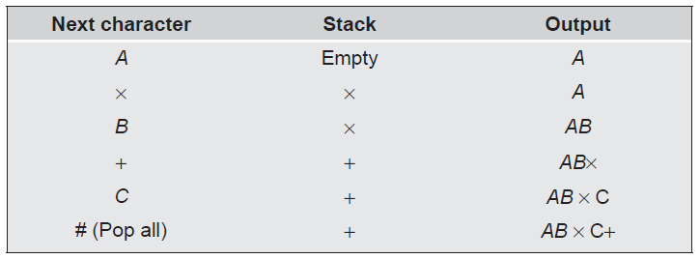
Example 3 (Testing)
E = A x B + C#.

Slide 40
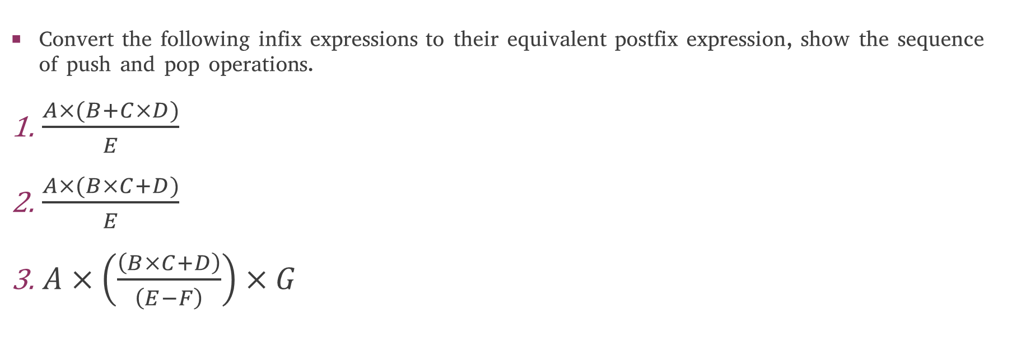
Excersice
Convert the following infix expressions to their equivalent postfix expression, show the sequence of push and pop operations.
$\frac{A×(B+C×D)}{E}$
$\frac{A×(B×C+D)}{E}$
$A×\left(\frac{\left(B×C+D\right)}{\left(E−F\right)}\right)×G$

Slide 41
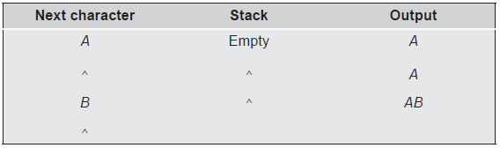
Example 4 (Testing)
X = A ^ B ^ C
If we use the previous rule, do we get the correct postfix expression?

Slide 42
Solution
We must take into account the associativity of operators and prepare a hierarchy scheme for the binary arithmetic operators and delimiters.
When an operator is at the top of the stack or in an expression (current token), they are to be treated with different priorities.
Hence, each operator is to be assigned two priorities—the incoming priority (ICP) and the in-stack priority (ISP).
In previous examples, we observed that the lower priority operators should spend more time in the stack and the higher priority operators should be popped out earlier.
To achieve this, we need to assign the appropriate ICPs and ISPs to the operators.

Slide 43
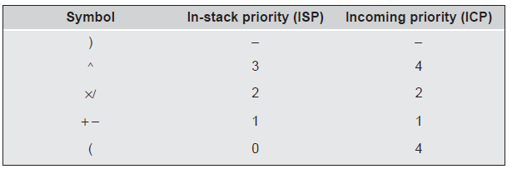
Points to be Taken into Consideration While Assigning ICPs & ISPs:
Higher priority operators should be assigned higher values of ISP and ICP.
For right associative operators, ISP should be lower than ICP. For example, A ^ B ^ C should generate ABC^^, which means (A) ^ (B ^ C).
If ICP is higher than ISP, the operator should be stacked.
The ISP and ICP should be equal for left associative operators.

Slide 44
Summing up
The following are the steps involved in the evaluation of an expression.
Assign priorities to all operators and define associativity (left or right).
Assign appropriate values of ICPs and ISPs accordingly. For left associative operators, assign equal ISP and ICP. For right associative operators, assign higher ICP than ISP. For example, assign a higher ICP for ‘^’.
Scan the expression from left to right, character by character, till the end of expression.
If the character is an operand, then display the same.
If the character is an operator and if ICP > ISP
then push the operator
else
while(ICP <= ISP)
pop the operator and display it.
end while
Stack the incoming operator
Continue till end of expression
The expression could be in one of the three forms—infix, postfix, or prefix.

Slide 45
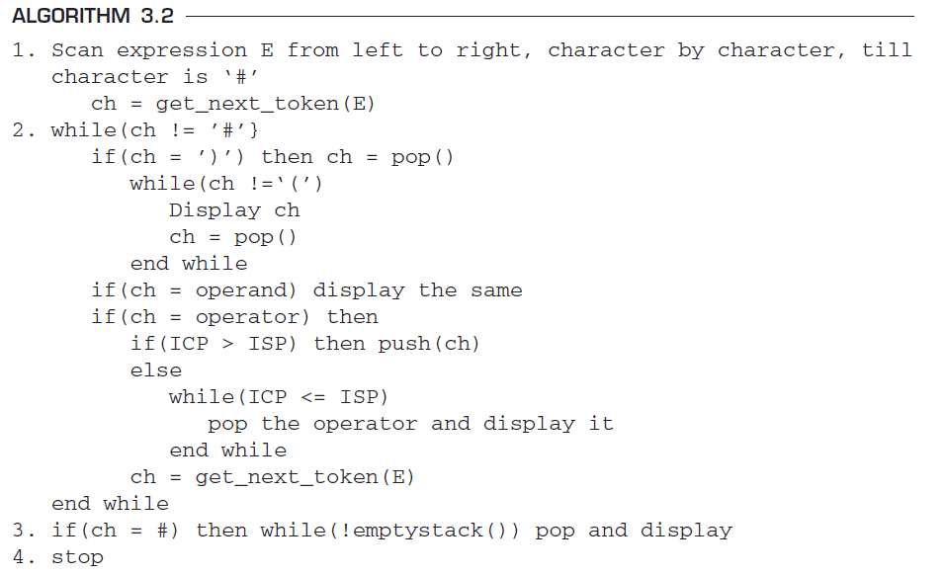
Infix to Postfix Conversion Algorithm

Slide 46
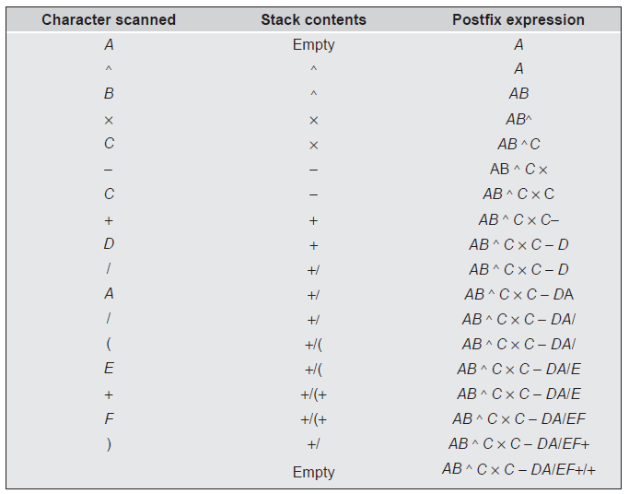


Convert the following infix expression to its postfix form:

Slide 47
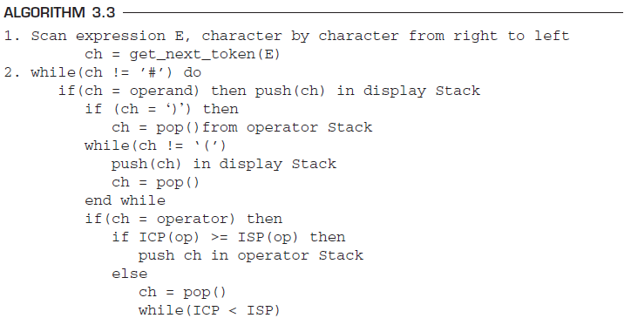
Infix to Prefix Conversion Algorithm
For converting the infix expression to a prefix expression, two stacks are needed—the operator Stack and the display Stack. The display Stack stores the prefix expression.

Slide 48
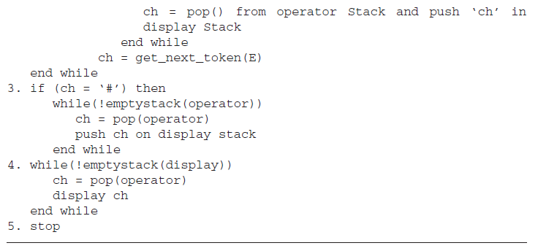

Slide 49
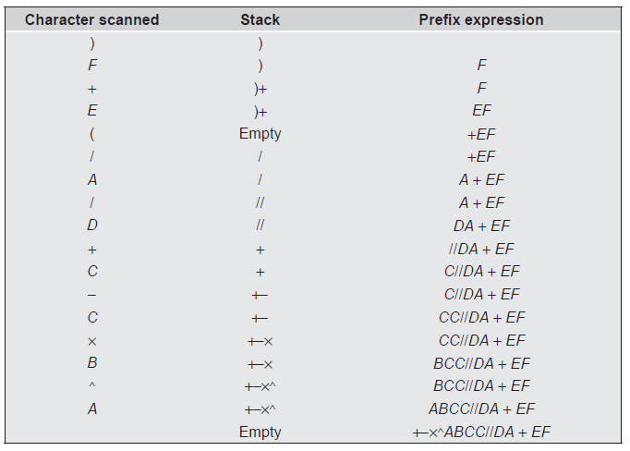
Convert the following infix expression to its prefix form:

Slide 50
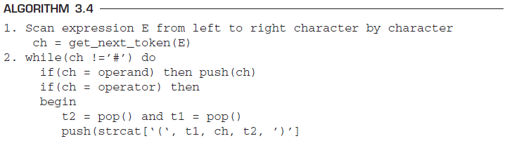
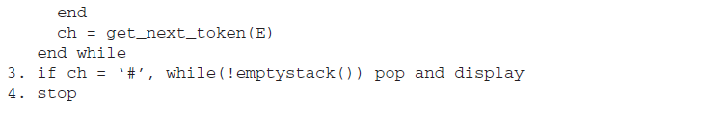
Postfix to Infix Conversion Algorithm

Slide 51
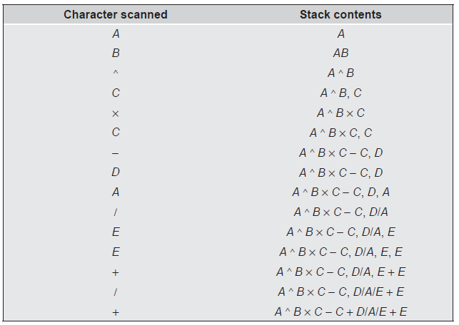
Convert the following postfix expression to its infix form:

Slide 52
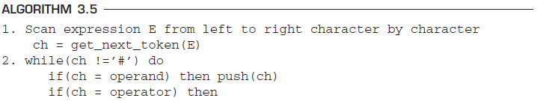
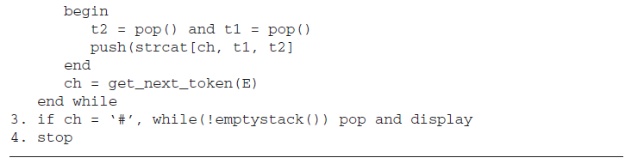
Postfix to Prefix Conversion Algorithm

Slide 53
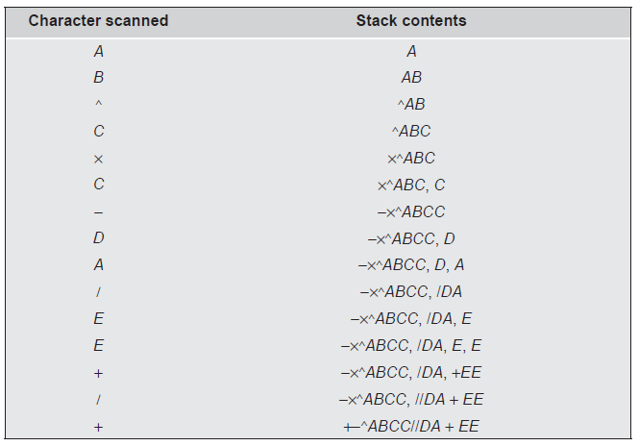
Convert the following postfix expression to its prefix form:

Slide 54
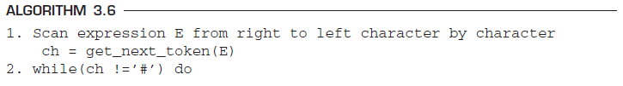
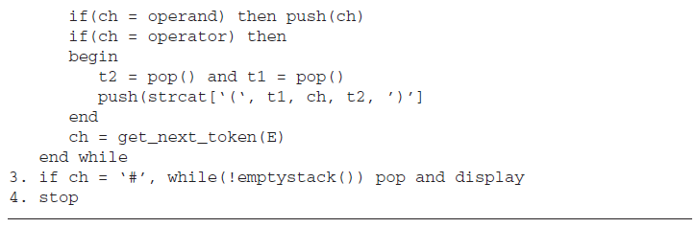
Prefix to Infix Conversion Algorithm

Slide 55
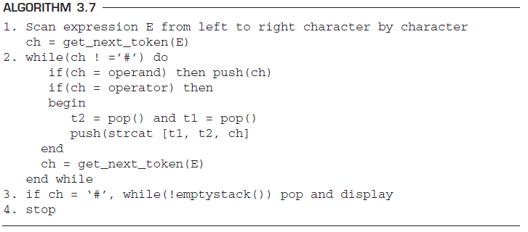
Prefix to Postfix Conversion Algorithm

Slide 56
A3: checking CORRECTNESS OF WELL-FORMED PARENTHESES
Consider a mathematical expression that includes several sets of nested parentheses. For example,
To ensure that the parentheses are nested correctly, we need to check that
  There are equal numbers of right and left parentheses
  Every right parenthesis is preceded by a matching left parenthesis.
To solve this problem, let us define the parentheses count = the number of left parenthesis minus the number of right parenthesis
The two conditions that must hold if the parentheses in an expression form an admissible pattern are as follows:
  The parenthesis count at each point in the expression is non-negative.
  The parenthesis count at the end of the expression is 0.

Slide 57
Cont.…
A stack may also be used to keep track of the parentheses count.
Whenever a left parenthesis is encountered, it is pushed onto the stack, and whenever a right parenthesis is encountered, the stack is examined.
If the stack is empty, then the string is declared to be invalid.
In addition, when the end of the string is reached, the stack must be empty; otherwise, the string is declared to be invalid.

Slide 58
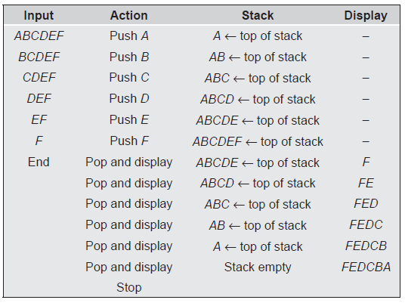
A4: REVERSING A STRING WITH A STACK
Suppose a sequence of elements is presented and it is desired to reverse the sequence.
Various methods could be used for this, and in the beginning, the programmer will usually suggest a solution using an array.
A conceptually simple solution, however, is based on using a stack.
The LIFO property of the stack access guarantees the reversal.
Suppose the sequence ABCDEF is to be reversed.

Slide 59
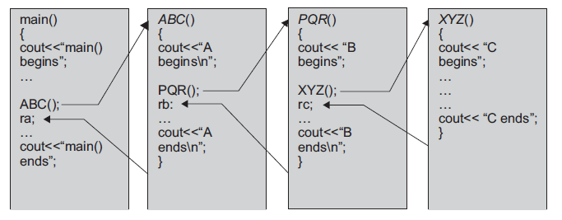





A5: Processing Of function calls
The processing of function calls and their terminations can be controlled with stacks easily & efficiently.
The program must remember the place where the call was made so that it can return there after the function is complete.
The sequence by which a function actively proceeds is summed up as the LIFO or FILO property

Slide 60

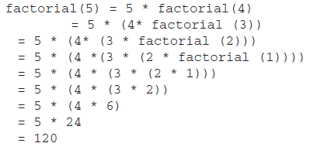

A7: RECURSION
In C/C++, a function can call itself, that is, one of the statements of the function is a call to itself.
Such functions are called recursive functions and can be used to implement recursive problems in an elegant manner.
To solve a recursive problem using functions, the problem must have an end condition that can be stated in non-recursive terms.

Slide 61
Recursion is a technique that allows us to break down a problem into one or more sub-problems that are similar in form to the original problem.
Recursive programs are most inefficient as regards their name and space complexities.
Hence, there is a need to convert them into iterative ones. To achieve this conversion stacks need to be used.

Slide 62
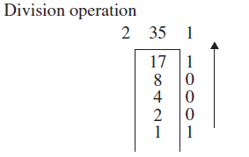

A8: converting DECIMAL NUMBERS TO BINARY
To convert a number from decimal to binary, we simply divide the number by 2 until a quotient of 0 is reached.
Then, use the successive remainders in reverse order as the binary representation.
For example, to convert decimal 35 to binary, we perform the following computation:
We need some intermediate storage that will hold the result and finally send the output as the correct result.
If we store every bit generated in a stack, we will get the correct result at the end. This is because the working behavior of the stack is LIFO.

